Slide 1
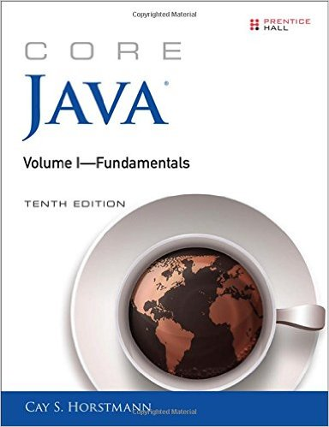
Ch 03: Fundamental Programming Structures in Java Part_2
Core Java, Volume I

Slide 2
3.6.6 Code Points and Code Units in a Java String
In character encoding system, a code point or a code position is any of the numerical values that make up the code space
Example 1: ASCII encoding system has 128 code points from 0 hex to 7F hex
Example 2: Extended ASCII has 256 code points from 0 hex to FF hex
Example 3: Unicode encoding scheme has 1,114,112 code points from 0 hex to 10FFFF hex
The Unicode code space is divided into 17 code planes, each plan has 65,536 code points
Hence, the total size of the Unicode code point is 17*65,536=1,114,112.
Note: a particular code space can be encoded in different encoding scheme
Example: Unicode code space can be encoded by three types of Unicode Transformation Format(UTF) encoding systems, namely:
UTF-8, UTF-16 and UTF-32.

Slide 3
3.6.6 Code Points and Code Units in a Java String
The first 128 Unicode code points from U+0000 to U+007F are encoded
Using 8-bits in UTF-8 encoding system
Using 16-bits in UTF-16 encoding system
Using 32 bits in UTF-32 encoding system
b) The next 1,9200 characters from U+0080 t0 U+o7FF are encoded
Using 16 bits in UTF-8 encoding scheme
Using 16 bits in UTF-16 encoding scheme
Using 32 bits in UTF-24 encoding scheme

Slide 4
3.6.6 Code Points and Code Units in a Java String
In the UTF-16 encoding system,
a) To get the number of code units in a given string, use the
length() method of “String” class ( java.lang.String).
Example: String greeting = “Hello”;
int n = greeting.length(); //output is 5
Note: greeting .length() return the number of code units, not the Unicode characters
b) To get the true length of a string( the number of code points),
use the codePointCount() method of the string class
Example: int cpCount = greeting.codePointCount(0, geeting.length());

Slide 5
3.6.6 Code Points and Code Units in a Java String
c) To get the code unit at the ith position of the string, use charAt() method
Example: char first = greeting.charAt(0); // ‘H’
char last = greeting.charAt(greeting.length()-1); // ‘o’
d) To get the code point at the ith position of the string:
int index = greeting.offsetByCodePoints(0, i);
int cp = greeting.codePointAt(index);
To get all code points:
int[] codePoints = greeting .codePoints().toArray();

Slide 6
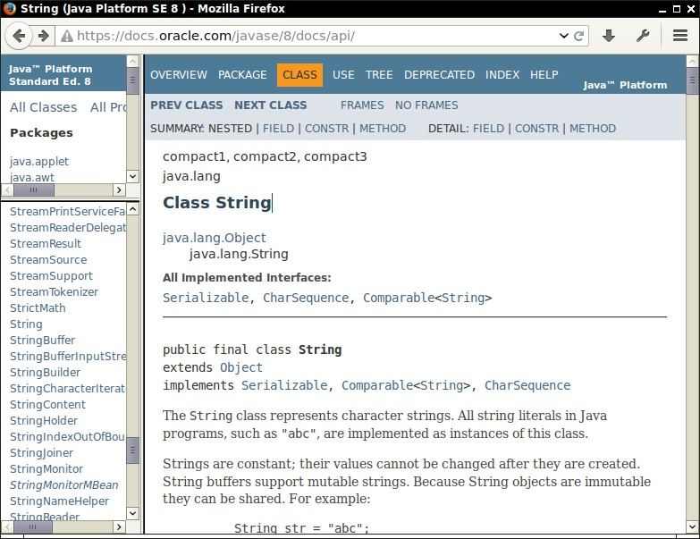
3.6.7. The String , StringBuffer and StringBuilder APIs
String class(java.lang.String) in java contains more than 50 methods.
See oneline API documentation which is part of the JDK (docs/api/index.html)
The API Screen shows packages and classes
Read the classes: java.lang.String, java.lang.StringBuffer, java.lang.StringBuilder

Slide 7
3.7. Console Input and Console Output in Java
a) To display output to the Standard output stream object (console window), call
System.out.println() method ;
b) To read text input from console easily, attach Scanner class (java.util.Scanner) with standard input stream object (System.in)
Example:
import java.util.*; // because scanner class is not available in the java.lang package
Scanner in = new Scanner(System.in);
System.out.print(“What is your name?”);
String name = in.nextLine(); // to read one line of text
String name = in.next(); // to read one word only
c) To read numbers:
nextInt()
netxDouble()
Example:
System.out.print(“What is your name?”);
String name = in.nextInt(); // to read an integer
// Note: we will study new key word and constructor of a class in ch4

Slide 8
Example: InputTest.java(Listing 3.2)
import java.util.*;
public class InputTest
{
public static void main(String[] args)
{
Scanner in = new Scanner( System.in );
System.out.print("What is your name? "); // Type: Kim
String name = in.nextLine(); // kim is stored in buffer
System.out.print("How old are you? "); // type 24.
int age = in.nextInt(); // 24 is stored in buffer
System.out.println("Hello, " + name + ". Next year, you'll be " + (age + 1));
} // output: Hello, Kim. Next year, you will be 25.
}

Slide 9
3.7.2. Formatted Output to Screen
Example:
double x=10000.0/3.0;
// 1. display: 3333.3333333333335( maximum number of digits)
System.out.printf (x);
// 2. display: Price: 3333.33 with 8 characters(leading space and 7 characters
System.out.printf ("Price:%8.2f", x);
// 3. prints: 3,333.33 using comma flag
System.out.printf( “ %, .2f ", x );
// 4. prints: we can use many format specifier
System.out.println( “Hello, %s. Next year, you will be %d ”, name, age );
// 5. to format and store without print, we can use the format() from String class
String message = String.format("Hello, %s. Next year, you'll be %d", name, age);
Note: Format Specifiers for each data type
f for floating-point, d for integer, s for strings and other objects.

Slide 10
3.7.3 File Input and File Output
To read textual data from a file, use the following steps
//Step 1: create Scanner object
import java.io;
import java.nio.path;
Scanner in = new Scanner( Paths.get("myfile.txt"), "UTF-8“ ); // similar to System.in
// Step 2: now read using the methods of Scanner class
b) To writing textual data to a file, use the following steps
//Step 1: create PrintWriiter object
PrintWriter out = new PrintWriter("myfile.txt", "UTF-8"); // similar to System.out.
// Step 2: now write textual data using the following methods of
PrintWriiter class
out.println(...) ;
out.print(...) ;
out.printf(...) ;

Slide 11
3.8 Control Flow
Like any programming Language, java supports both conditional statements and loops to determine control flow
The following are similar to C language.
Block Scope and Nested block
Conditional Statements
Loops
Determinate Loops
Multiple Selection -The Switch statement
Statements that break control flow
Read these concepts from your text book

Slide 12
3.9. Big Numbers
To get better precision for int and float data types, we can
use BigInteger and BigDecimal Classes from “java,math” package
import java,math.BigInteger;
Import java.math.BigDecimal;
We cannot use operators like +,- ,* , / and %
Hence, we will use add(), subtract(), multiply() etc methods
Reading Assignment
Compare the examples in Listing 3.5 and Listing 3.6

Slide 13
3. 10 Arrays: Traditional for Loop and Enhanced for Loop
An Array is a data suture to store many elements of the same type;
Syntax of declaration:
<data type><[ ]> <name> ;
a) Array variable declaration:
int[] a; // refrence array is created without initiation to actual array.
b) Use “new” operator to create actual array on heap area
int[] a = new int[100];
Example 1: Traditional Loop
for (int i = 0; i < a.length; i++)
System.out.println(a[i]);
Example 2: Enhanced loop
for (int element : a )
System.out.println(element) ;
a
null
a
an array
instance
(int[100])

Slide 14
3.10.2. Array Initializer
we can create an array object by supplying initial values without using “new” operator.
Example: int[] smallPrimes = { 2, 3, 5, 7, 11, 13 };
We can create an create and initialize anonymous array to re-initialize an existing with out creating a new variable.
Example:
Line 1: int[] smallPrimes = { 2, 3, 5, 7, 11, 13 };
Line 2: smallPrimes = new int[] { 17, 19, 23, 29, 311, 37 } ;
//This is the same as the following three lines of code.
Line 1. int[] smallPrimes = { 2, 3, 5, 7, 11, 13 };
Line 2. int[] LuckyNumbers = { 17, 19, 23, 29, 311, 37 } ;
Line 3. smallPrimes = LuckyNumbers;
17,19,23,29,31,37
samllPrimes

Slide 15
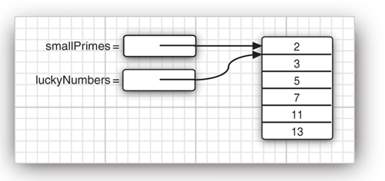
3.10.3 Show copy and Deep Copy of an Array
Shall copy: Copying array variables yields two references on stack area to the same array object on heap area:
Example: int[] luckyNumbers = smallPrimes;
Deep copy: we want copy to deep copy into new array on heap area, copyOf () method of Array class (java.util.Arrays) .
Example: int[] copiedLuckyNumbers = Arrays.copyOf (luckyNumbers, luckyNumbers.length);

Slide 16
3.10.4. Command Line arguments
// Message.java
Public class Message
{
public static void main( String[] args )
{
for (int i = 1; i < args.length; i++)
{
System.out.printf( “ “ + args[i] )
//Complie :
javac Message.java
// Run:
java Message Good By My Friend
// display : Good By My Friend because
// args[0] =“ Good”
// args[1] =“ By ”
// args[2] =“ My ”
// args[3] =“ Friend ”

Slide 17
3.10.5. Array Sorting
To sort the elements of an array, we use sort() method of “Arrays” class (java.util.Arrays)
In addition to sorting, Array class has many static methods as listed below.
static void sort(type [] a);
// type : int, long, short, char, byte, float, or double
static int binarySearch(type [] a, type v );
static void fill (type[]a, type v)
static Boolean equals(type [] a, type [] b);
static type [] copyOf (type [] a, int length);
See java.util.Arrays from online java API.
Example: write a program that draws a random combination of numbers for a lottery game.

Slide 18
Example: LotteryDrawng.java
import java.util.*;
public class LotteryDrawing
{
public static void main(String[] args)
{
Scanner in = new Scanner(System.in);
System.out.print("How many numbers draw? ");
int k = in.nextInt();
System.out.print("What is highest number? ");
int n = in.nextInt();
// fill an array with numbers 1 2 3 . . . n
int[] numbers = new int[n];
for (int i = 0; i < numbers.length; i++)
numbers[i] = i + 1;
// draw k numbers and put them into a second array
int[] result = new int[k];
for (int i = 0; i < result.length; i++)
{
// make a random index between 0 and n - 1
int r = (int) (Math.random() * n ); // scale: 0<=x< 1
// pick the element at the random location and copy
result[i] = numbers[r];
// move last element into random location for uniqueness
numbers[r] = numbers[n - 1];
n--; // reduce the size because of uniquness
} // end of for loop
// print the sorted array
Arrays.sort(result);
System.out.println("Bet as follows. It'll make you rich!");
for (int r : result)
System.out.println(r);
} // end of main method
} // end of lottery drawn
Example: k=6 and n=49
Output : 4, 7,8, 19, 30, 44

Slide 19
3.10.6. Multidimensional Arrays
A) with initializer: // an array of arrays or a two-dimensional array:
int[][] magicSquare = { { 16, 3, 2, 13 }, { 5, 10, 11, 8 }, { 9, 6, 7, 12 },
{ 4, 15, 14, 1 } };
b) Without initializer:
int[][] magicSquare = new int[ROWS][COLUMNS];
Use loop to traverse the elements:
for (int[] row : magicSquare)
for (int element : row)
do something with value
Example: write a program that stores in table the grow an initial investment at different interest rate and re-invested annually.

Slide 20
Example: CompoundInterest.java
Public class CompoundInterst
{
public static void main(String[] args)
{
final double STARTRATE = 10;
final int NRATES = 6; // number of rates( columns)
final int NYEARS = 10; // number of years( rows)
// set interest rates : 10%,11%,12%, 13%, 14% ,15%
double[] interestRate = new double[NRATES];
for (int j = 0; j < interestRate.length; j++)
interestRate[j] = (STARTRATE + j) / 100.0;
double[][] balances = new
double[NYEARS][NRATES];
// set initial balances to 10000
for (int j = 0; j < balances[0].length; j++)
balances[0][j] = 10000;
// compute interest for future years
for (int i = 1; i < balances.length; i++)
{
for (int j = 0; j < balances[i].length; j++)
{
// get last year's balances from previous row
double oldBalance = balances[i - 1][j];
// compute interest
double interest = oldBalance * interestRate[j];
// compute this year's balances
balances[i][j] = oldBalance + interest
} // end of inner Loop
} // end of Outer loop
// print one row of interest rates
for (int j = 0; j < interestRate.length; j++)
System.out.printf("%9.0f%%", 100 * interestRate[j]);
System.out.println();
// print balance table
for (double[] row : balances)
{
// print table row
for (double b : row)
System.out.printf("%10.2f", b);
System.out.println();
}// end of loop
}// end of main()
} end of Comppund Interst

Slide 21
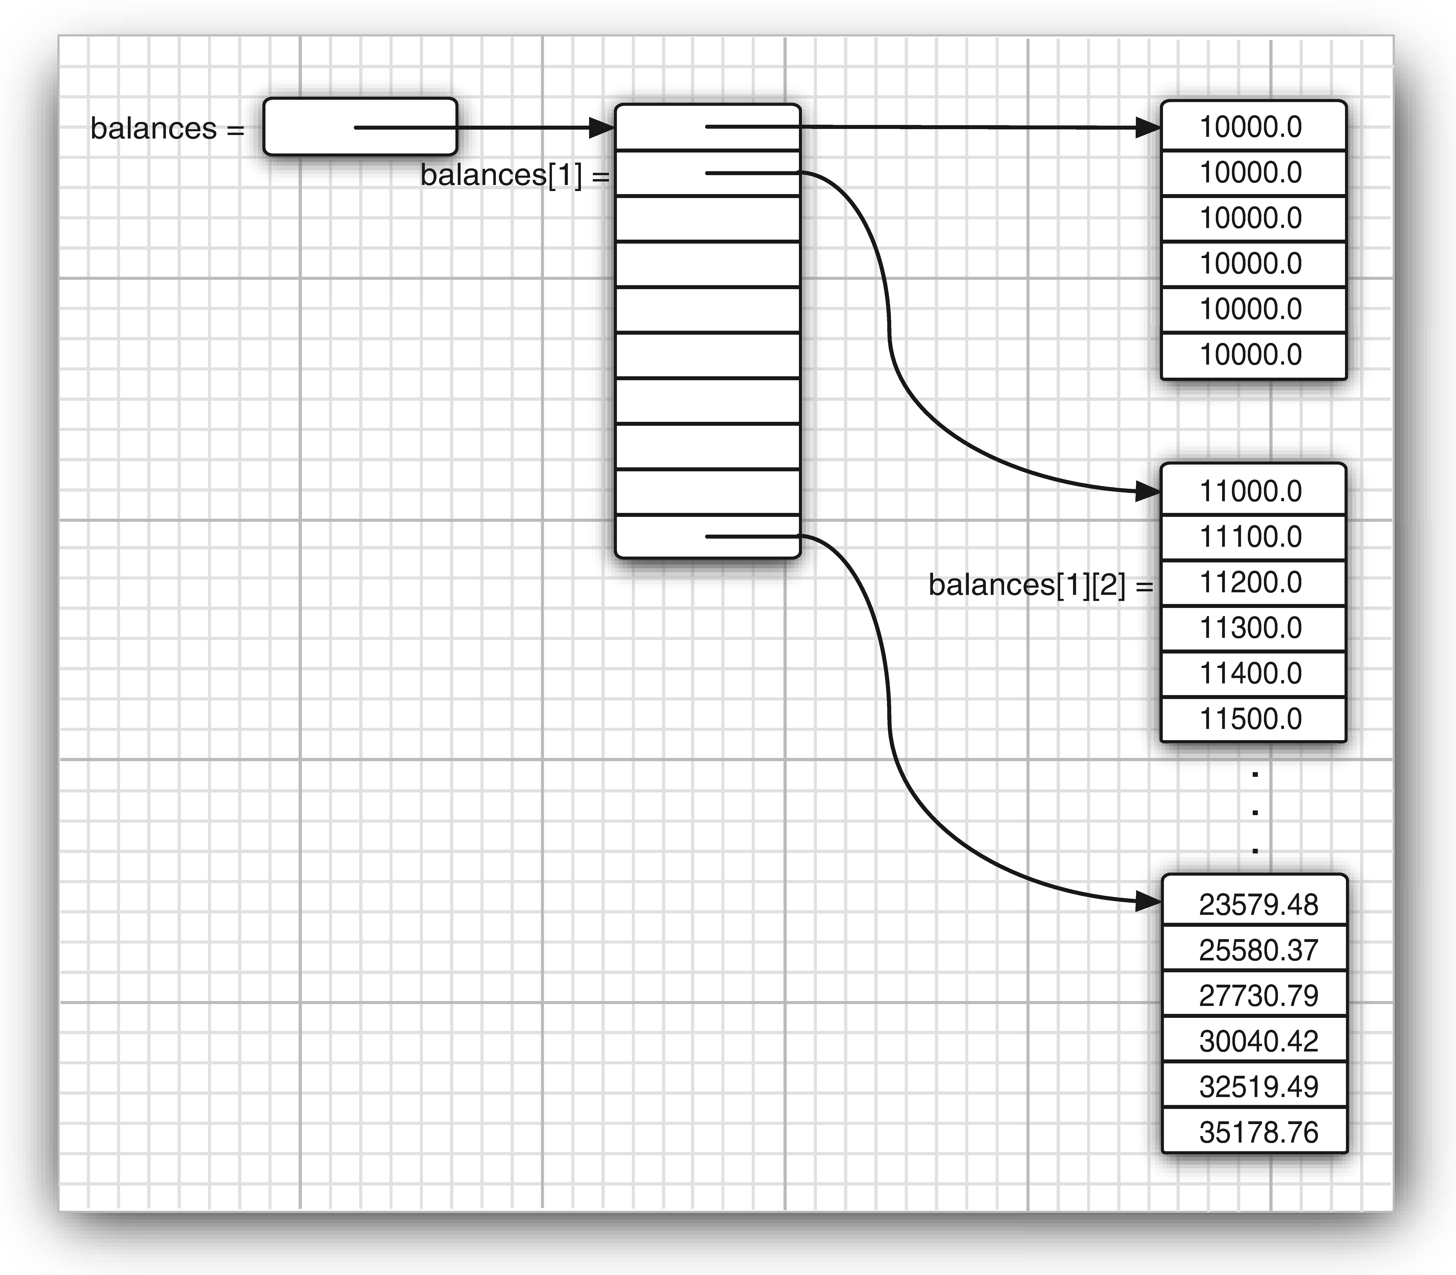
3.10.6. Multidimensional Arrays
Example: CompoundInterest.java

Slide 22
3.10.7. Ragged Arrays
In java, Multidimensional arrays are faked as “arrays of arrays”.
Hence, Java has no multidimensional array at all; It ha only one-dimensional array.
Example: balances array is an array that contain 10 elements and again each element is an array of 6 numbers.
The expression balances[i], refers to the ith subarray of the original array.
Hencebalances[i,j] refers to the jth element of ith subarray
Ragged arrays: different rows may have different lengthsExample:
Example:
int[][] odds = new int [7] [];
for (int n =0; n<7; n++)
odds[n] = new int [n+1]; // allocate each row
1
1 1
1 2 1
1 3 3 1
1 4 6 4 1
1 5 10 10 5 1
1 6 15 20 15 6 1
Odds [i][j]

